Slide 1

Raspberry Pi
Submitted To: Submitted By:
Mrs. Prachi Singh Gaurav Taluja
Asst. Professor CSE-B1
(CSE Department) 0905CS141053

Slide 2
What is Raspberry Pi??

Slide 3
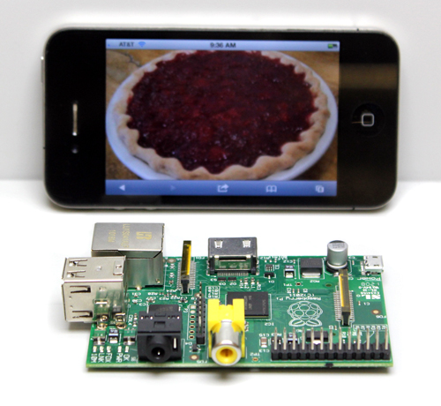
Introduction
Measuring approximately 9cm x 5.5cm

Slide 4
History
The Raspberry Pi is the work of the Raspberry Pi Foundation, a charitable organisation.
UK registered charity (No. 1129409), May 2009.
It's supported by the University of Cambridge Computer Laboratory and tech firm Broadcom.

Slide 5
Features
Ultra low-cost (Model A $25, Model B $35)
Ultra low-power ~1W
Complete easy-to-program computer
Fun computer for children to experiment with at home(programming, robotics, etc...)

Slide 6
Technology
The Raspberry Pi has a Broadcom BCM2835 system on a chip (SoC),which includes an ARM1176JZF-S 700 MHz processor
Video Core IV GPU
Originally shipped with 256 megabytes of RAM, later upgraded to 512MB.
It does not include a built-in hard disk , but uses an SD card for booting and long-term storage.
The processor in the Raspberry Pi has about twice the graphics performance of the iPhone 4S and even bests Nvidia’s Tegra 2.
Notes:
The ARM1176™ applications processors deployed broadly in devices ranging from smart phones to digital TV's to eReaders, delivering media and browser performance, a secure computing environment, and performance up to 1GHz in low cost designs. The ARM1176JZ-S processor features ARM TrustZone® technology for secure applications and ARM Jazelle® technology for efficient embedded Java execution.

Slide 7
Hardware
10/100 BaseT Ethernet socket
HDMI socket
USB 2.0 socket
RCA video socket
SD card socket
Powered from microUSB socket
3.5mm audio out jack
Header footprint for camera connection

Slide 8
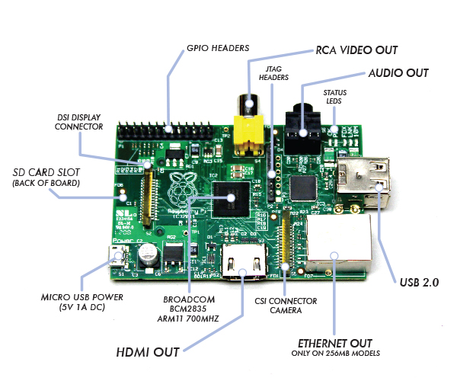

Slide 9
Operating System
Linux on a bootable SD card
Fedora
Raspbian
Debian
ArchLinux ARM

Slide 10
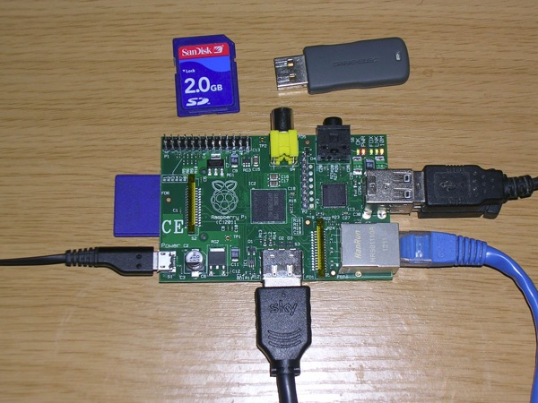
How to make it work!

Slide 11
Programming
Any language which will compile for ARMv6 can be used with the Raspberry Pi.

Slide 12
Price
Model A - $ 25
Model B - $ 35

Slide 13
Why so cheap??

Slide 14
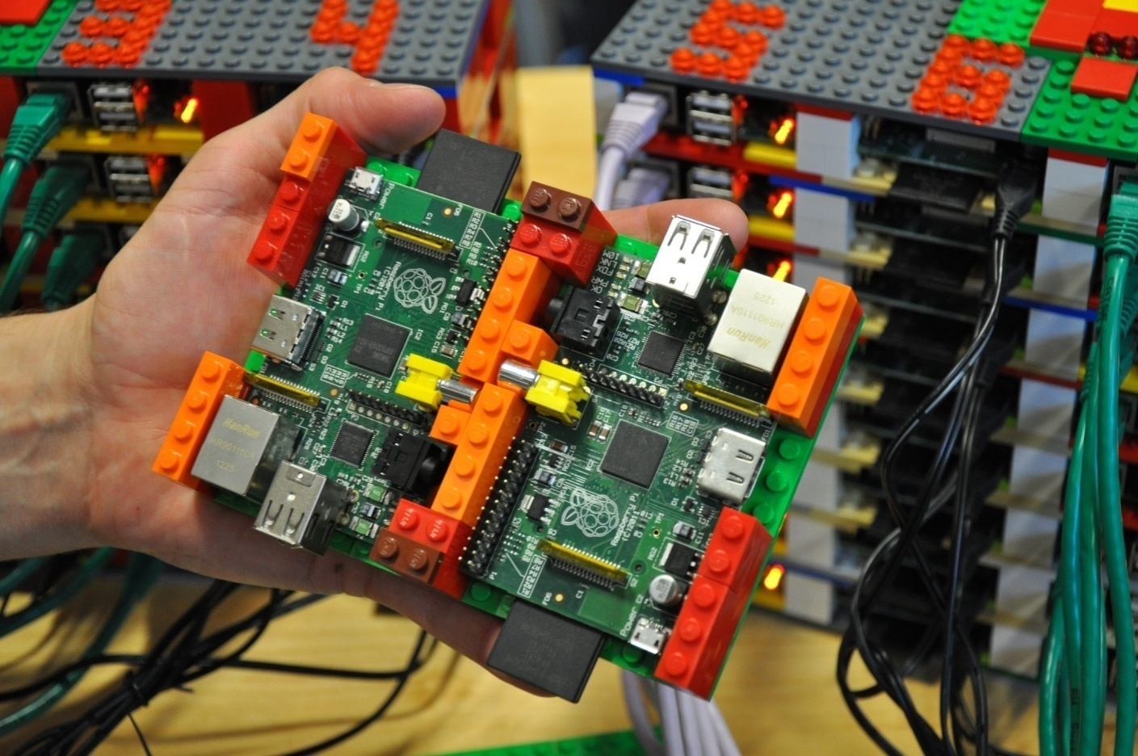
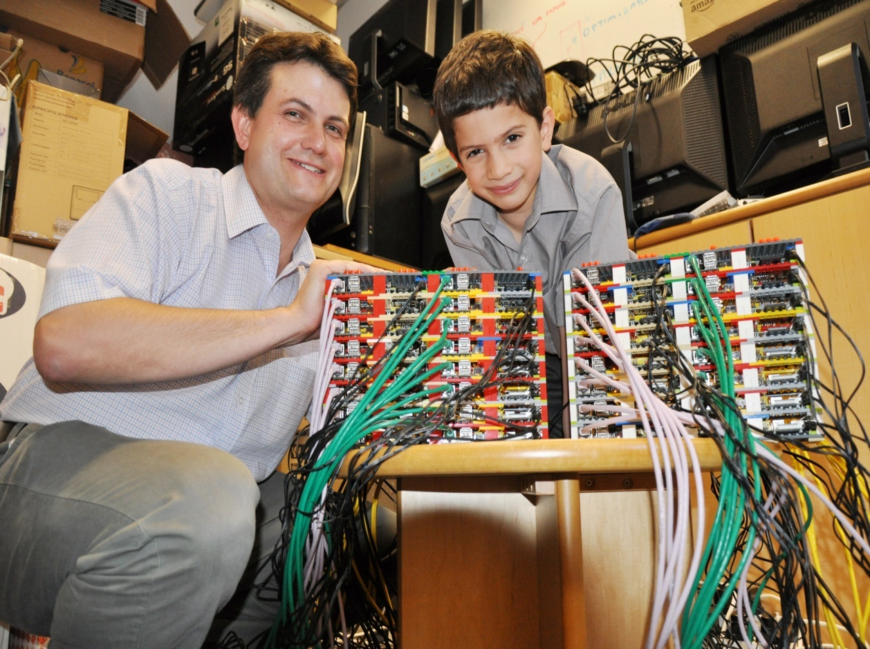
Applications
Can be used for making super computers

Slide 15
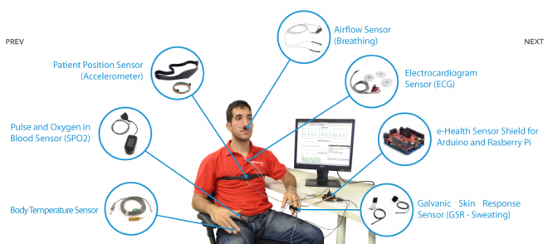
Applications
Raspberry Pi Medical Device Input Shield

Slide 16
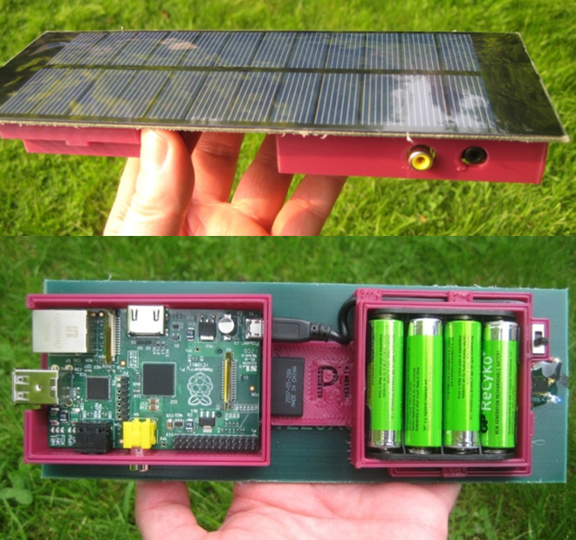
Applications
Solar Raspberry Pi Power Pack

Slide 17
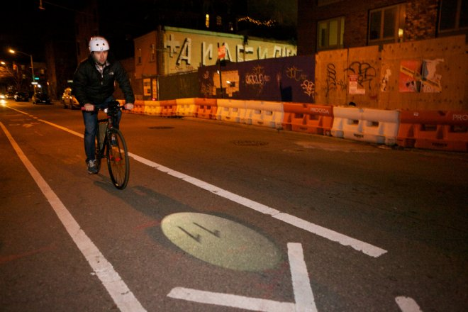
Applications
Raspberry Pi Dynamic Bike Headlight Prototype

Slide 18
Applications
It can make your Old TV in to a smart TV. (You can play Videos, 3D Games, Music, Browse Internet and much more.
Raspberry Pi can Act as Full HD 1080p Media Player.
Its a Mini Computer which just cost Rs.2,350/-
You can connect a Monitor, Keyboard and Mouse and use it as a normal computer.
Its Graphics Capabilities is better than Apple Products.

Slide 19
Raspberry Pi Vs Aakash
Aakash is a low-cost tablet, and Raspberry Pi is an ultra-cheap.
The Raspberry Pi can connect to a television or a computer monitor via the commonly used composite RCA and HDMI video interfaces.
The first generation Aakash is said to run an ARM 11-based processor from Conexant whereas the Raspberry Pi uses an ARM 11-based processor from Broadcom.

Slide 20
Disadvantages
It does not have a Hard Disk.
There is no Real time clock associated with the board.

Slide 21
Future developments
● Tablet version.
● Interesting low-cost screen technologies emerging.

Slide 22
Raspberry Pi 2020
● Exploit process scaling and keep price constant:
– 8 cores, improved GPU, 8GB main memory
– WiFi, camera, matchbox sized case
– holographic laser projector, virtual keyboard
– FPGA logic on main SoC, high speed links, ….
– < $25
Notes:
A field-programmable gate array (FPGA) is an integrated circuit designed to be configured by a customer or a designer after manufacturing—hence "field-programmable“FPGAs contain programmable logic components called "logic blocks", and a hierarchy of reconfigurable interconnects that allow the blocks to be "wired together"

Slide 23
REFERENCES
Electronics For You, November 2012, Page 18
http://en.wikipedia.org/wiki/Raspberry_Pi
http://www.raspberrypi.org
http://www.element14.com/community/groups/raspberry-pi

Slide 24
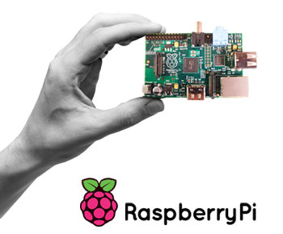
THANK YOU

